Slide 1

Application of Fourier transform
in Quantum Mechanics
By: 20PW17, 20PW18, 20PW19

Slide 2
Science dealing with behaviour of matter/ light in the atomic and subatomic level.
Works on the 4 basic principles:
Physical States
Physical Quantities
Composition
Dynamics
What is
Quantum Mechanics?
All objects are considered to have wave-particle properties.

Slide 3
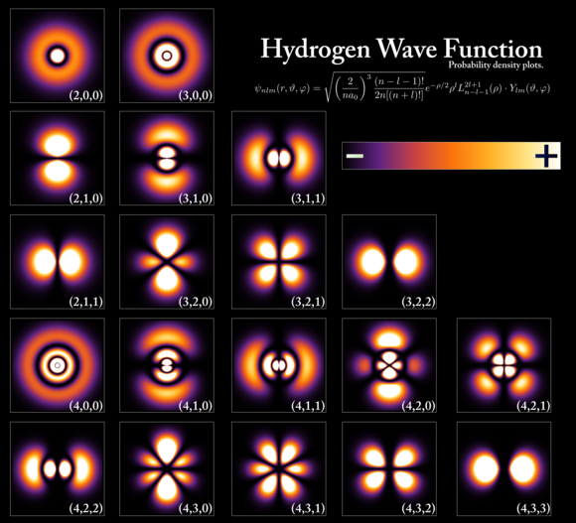
Trying to explain theories from observations that classic Physics explains to do.
Not completely predictable, just calculated as probability of a phenomena occurring.
Ultimately, these are theoretical estimations.

Slide 4
Consequences of Quantum Mechanics
Impossible to have a precise prediction for a quantum particle:
Thus comes the Heisenberg's Uncertainty Principle:
"The position and the velocity of an object cannot both be measured exactly, at the same time, even in theory. "

Slide 5
Consequences of Quantum Mechanics
Quantum Interference:
Two waves collide and form a different wave of different amplitude. Sometimes its amplitude is same as one of the wave.
We try to study the interference pattern using the double slit experiment.

Slide 6
Consequences of Quantum Mechanics
Quantum Tunnelling:
A particle passes through a potential barrier even if its kinetic energy is much smaller than that of the potential barrier.
This enables the radioactive decay, nuclear fusion in stars, etc.

Slide 7
So to understand Quantum mechanics despite having consequences, we use some mathematical formulations and study its phenomenas
Widely used ones are Linear Algebra, Differential Equation concepts
and Fourier transforms

Slide 8
Simplifies complex theories proposed by physicists by breaking down into simpler forms of equations for better results
Some of the principles of Quantum Mechanics that use Fourier Transforms are principles conceived by Planck, de Broglie, Dirac, Heisenberg, Bohr.
Fourier transform
in Quantum Mechanics
Using theorems of 3D Fourier transform, we can unite various laws in wave optics.

